Slide 1

Sales Dataset Analysis 2022-2025
Welcome to my Presentation

Slide 2

Agenda
Introduction
Blank Fills
Client Requirements
PivotCharts
Explanation
Dashboard

Slide 3
1.INTRODUCTION
We are going to analyze a Sales dataset. First of all, the given dataset contained 16,04,497 records. After obtaining the dataset, it was cleaned and analyzed. The empty cells were filled with a hyphen (“-”) or “Not-Provided” or “N/A” or “Invalid” where required. Next, the data was sorted, and duplicate values were checked. Out of the 16,04,497 records, 5000 duplicate values were removed, leaving 1,50,001 unique records. After that, functions, logical functions, and data validation tools were used according to the client’s requirements. Then, the required details were converted into PivotTables and PivotCharts. Finally, a dashboard was created to provide a visual representation of the data, which helps in gaining insights and supporting decision-making based on the dashboard content.

Slide 4
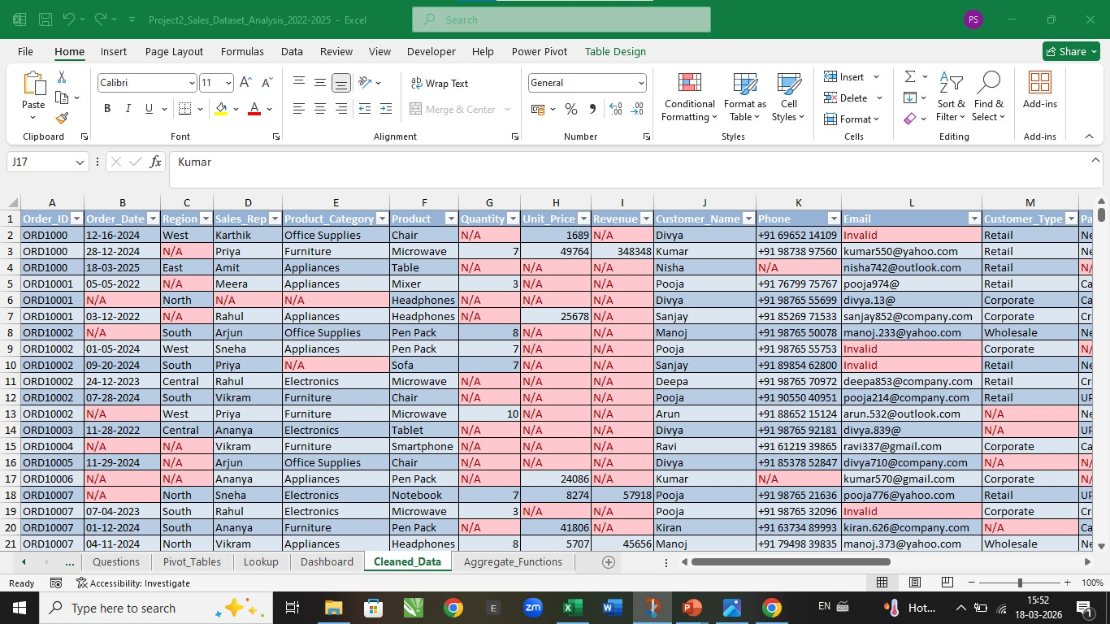
2.BLANK FILLS

Slide 5
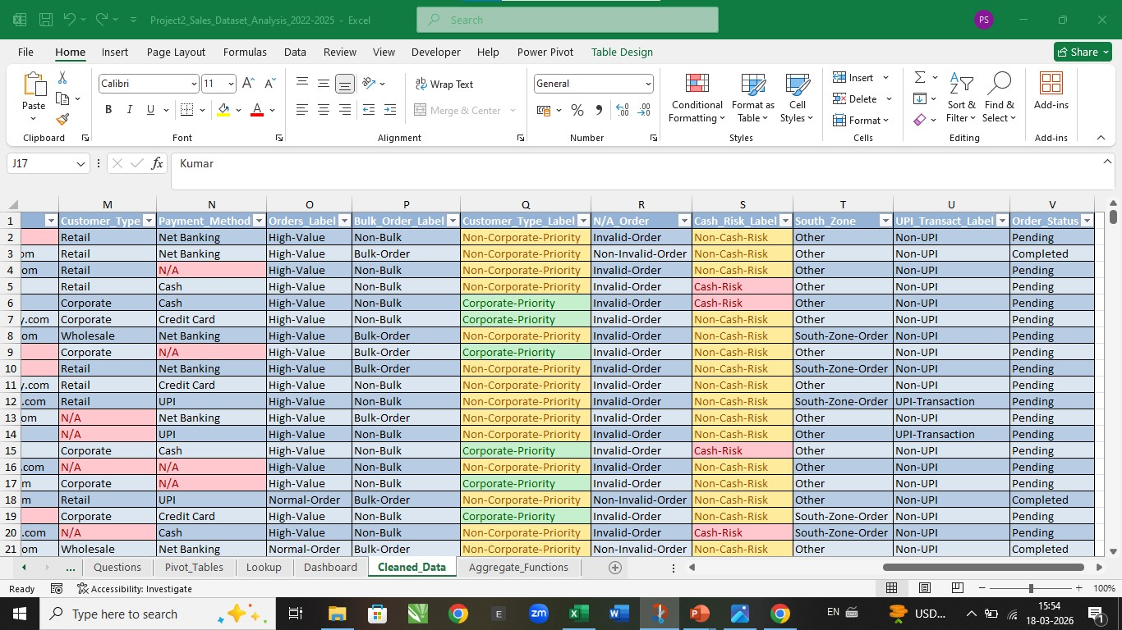
3.CLIENT REQUIREMENTS

Slide 6
Total Revenue by Region

Slide 7
Major Explanation 1
The chart represents the Total Revenue by Region the Most Revenue of Region is North(574.39 M) & Least Revenue is West(281.61 M).

Slide 8
Sum of Revenue by Product Category

Slide 9
Major Explanation 2
The chart represents the Sum of Revenue by Product Category the Most Revenue of Product is Office Supplies(679.65 M) & Least Revenue is Appliances (314.42 M).

Slide 10
Sum of Revenue by Sales Rep

Slide 11
Major Explanation 3
The chart represents the Sum of Revenue by Sales Rep the Most Revenue by Sales Rep is N/A(217.04 M) & Least Revenue is Ananya(201.11 M).

Slide 12
Revenue Trend

Slide 13
Major Explanation 4
The chart represents the Revenue Trend the Most Revenue of Top Date is N/A.

Slide 14
Count of Region by Payment Mode

Slide 15
Major Explanation 5
The chart represents the Count of Region by Payment Mode the Most Count of Region in the payment is Cash(49703) & Least Count is UPI(24830).

Slide 16
Count of Product Category by Region

Slide 17
Major Explanation 6
The chart represents the Count of Product Category by Region the Most Count of Product in the region is North(37500) & Least count is Central(18696).

Slide 18
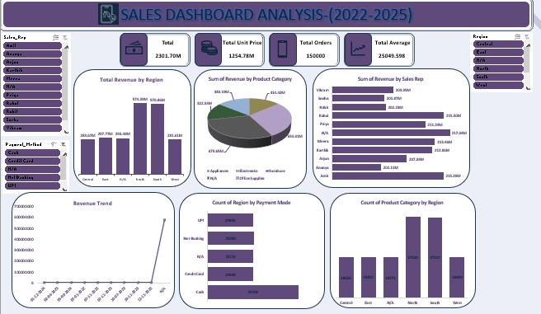
6. Dashboard

Slide 19
Thank You
PORNIMAA S
spornimaa@0504gmail.com
9360461108
https://github.com/PornimaaS-050421/Project2_Sales_Dataset_Analysis_2022-2025

